Slide 1
Services
Naveen

Slide 2
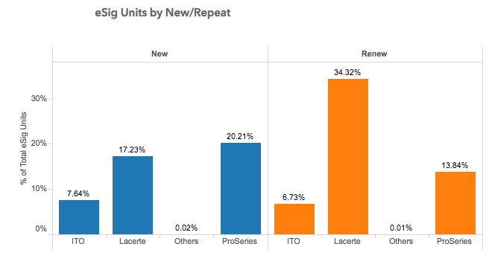
TY17 Durable services
E-Signature
49% growth in firms
29% growth in units
ACS
handled ~20,000 TPM.
~100 million calls during peak season

Slide 3
TY17 Learnings
Went well
Deliberate focus on E-Ssignature improvements
Strong collaboration between Care, Lacerte and Services team
Good support during season between IDC and Plano services teams
Docker-ized services have been stable in production
Launched new Tax Engagement Service on V4
Focus on speed as a habit – data backed approach to reduce cycle time
Project Trinity
Opportunities
“Big-Bang” release of engagement V4
Better E2E support
Unresolved E-Signature issues
EBS issues with purchase

Slide 4
What we aspire to do
Improved customer experience
Re-imagine E-Signature
Reduce RTB
Roll-over – go deep into rollover for TY18 and eliminate for TY19
AWS - durable services on AWS
ACS on Docker and de-composing ACS
Security – exit SafeNet and consolidate on IDPS
Developer productivity
CICD Pipe-line
Continuous Performance Testing
Self-Healing systems in E2E
Our 3x in 3 goal
3 services on AWS in 3 quarters
No support engineer needed
Less than 10% RTB

Slide 5
Services in the Future
App Server
Web Services
Security
Business Logic
Messaging
Business Logic
Logging
Persistence
Lambda
Monitoring
Database
Analytics
AWS

Slide 6
Implications
End User
End User
Feature Dev
Feature Dev
Tech Refresh
Devops
Performance
Dependencies
Logging
Security
Monitoring
Availability

Slide 7
Thank You !
Q & A

